Slide 1
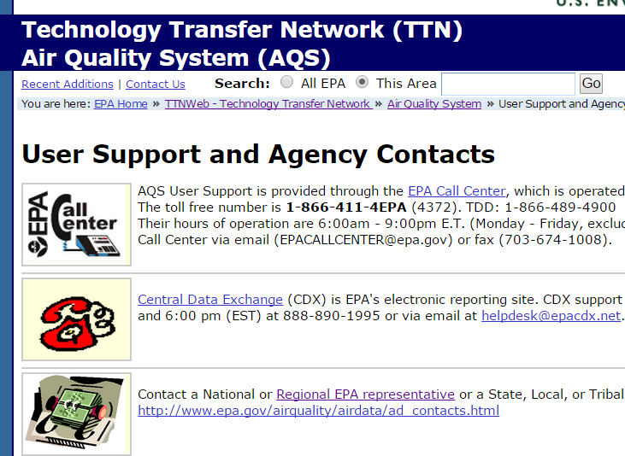
Creating a Site in AQS:
Print AQS Site form and fill out beforehand
Your Tribal Code (easy to find in AQS)
Your site id –
AQS Data Coding Manual for reference
Contact information of person who set up site
Contact information for your AQS Regional Representative—google EPA AQS Support
http://www.epa.gov/ttn/airs/airsaqs/AQSROContacts.pdf

Slide 2
Site ID attributes
Alphanumeric
4-digit ID
Mandatory
Key Field
Notes:
These are the site id attributes.
2.2.6 Key Fields
Certain mandatory fields are also labeled as “Key” fields. These fields are used to uniquely identify specific data in the database. For example, for a Monitor Sampling Period, the Date Sampling Began, is a key field. It, along with {state, county, site, parameter, and POC} uniquely identifies one row of data in the database. Key fields are always mandatory for all Action Indicators, and key fields cannot be modified by an update transaction.

Slide 3
Site Id:
Uniquely 4-digit identifier for each air monitoring site within a county or tribal area. Site IDs don’t have to be assigned continuously or in any order. Regional and Local organizations are thus free to allocate site numbers in any way they chose as long as there is no duplication within a county and tribal area. For Tribal sites, because tribal areas may cross county or state lines, care must be taken to ensure that the Site ID is unique in the effected Tribal Area and states-county.
A specific Site ID is associated with a specific physical location and address. Any change in address requires a new Site ID to be assigned. This address change could include a change from the roof of one building to another. A change in location on the same roof should not normally require a new Site ID. Although an address change would routinely mean a new Site ID, some changes that do not change the site's location in respect to surrounding sources and its measurement scale, would require no change. An EPA Regional Office should be consulted for assistance in determining whether a new Site ID is required. If a new Site ID is needed for a site not operated by the air pollution control agency, that agency should be contacted to assist in the ID assignment, to ensure that the ID is unique within the county. In other words, when a new Site ID is assigned, it must be different from any other Site ID already existing for that combination of State and County or Tribal Code
Notes:
Here is some information about the Site ID from the AQS Data Coding Manual.

Slide 4
Steps for inputting a site via online Maintenance
If not in Tribal Mode, access Tribal Mode.
Log into your screening group.
Go to Maintenance > Site to the Basic Site Data tab
On the Basic Site Data tab, click on Cancel Query button to access input mode
Enter tribal code
Enter state code
Enter your county code
Do not enter anything in the Status Ind
Enter Horizontal Datum
Enter Latitude/Longitude -OR- UTM Zone/UTM Easting/UTM Northing.
Click on Lookup Geography. This automatically populates the Standard Coordinates.

Slide 5
Setting up a Site via online Maintenance:
Enter the rest of the required fields (in Bold) on the Basic Site Data tab
Optional: Click on the ‘Additional Site Data’ tab and enter any site meta data; else leave blank
Required: Click on the Agency Roles tab and enter a Supporting Role and Date
Optional: Tangent Roles tab and specify if your site has one; else leave blank
Optional: Open Paths and specify if your site has one; else leave blank
Optional: Comments tab and specify comment if you want to specify a comment for your site; else leave blank
Do not specify anything on the Primary Monitor Periods tab at this point.
Go back to the Basic Site Data tab.
Click Save.
Notes:
Tangent Roads - The monitor's relationship to nearby streets may be described by using the MG transaction. If either tangent street number or distance from monitor is valued, the other must also be valued. Similarly, one may not be deleted without also deleting the other.
Open Path Number
Description: The specific open path number registered at the site that the monitoring data and monitor represent. The number must be registered at the site before it can be identified by the monitor.
Enter tribal code in addition to the state , county and site. This will associate the tribal code with your state, county and site.

Slide 6
Tips to Creating a Site Online:
A lot of the information on the Basic Site Data tab comes from whomever set up your site. Try to obtain this information before you begin inputting your site data in AQS, else you will not be able to finish. You can print the Basic Site Data screen in AQS beforehand and fill it out.
Obtain your Tribal Code from your AQS Regional Representative or the AQS Team.
You determine your site id. Review the sites you already have in AQS and decide upon a site or consult your regional representative regarding a Site Id
To create a site you access Maintenance>Site
Be sure to click on the Cancel Query button to access input mode before you start inputting your site data
Everything in bold on the Basic Site Data tab is required
After you enter the information on the Basic Site Data tab up to and including the UTM –or- Lat/Long, click on the Lookup Geography button to populate the standard coordinates.
The Agency Roles Tab>Supporting Roles is Required
Information is only required on the Basic Site Data Tab and Agency Roles tabs. The other tabs are site specific and/or optional…or input is required only for certain pollutants (i.e. primary monitor periods tab)
When the Status IND on Basic Site Data Tab changes from ‘F’ to ‘P’ or Production Status your site is complete and you are done (Note: you must add a monitor for the Status to change from ‘F’ to ‘P’). When your site is at ‘F’ Status only you and members of your screening group can see it. When your site is at ‘P’ status everyone can see your site.
Use the AQS Data Coding Manual if your are unsure of any terms on the site form.

Slide 7
More tips to Creating a Site Online:
To refresh, re-query your site by clicking on the enter query button. Enter your tribal code and site id, and then click on the Execute Query button. Click on the ‘Check Completeness’ button at the bottom of the Basic Site form and note any errors or missing data to fix. Fix any errors and Save again. Note: until you add your first monitor you will always have one Relational Error (‘To enter a new Site record, you must enter at least one Monitor record’) specified when you click on the Check Completeness button…this should be the only error you have.
Your site will have a ‘F’ Status Ind until you add your first monitor at the site. Once you add your first monitor the Site Status Ind will change to ‘P’ (Production)

